Slide 1

Seth Vishambhar Nath Institute of Engineering and Technology
Safedabad, Lucknow-Barabanki Highway, Barabanki – 225003, Uttar Pradesh, India
ElectroMart
A Full-Stack Electronic Commerce Web Application
AKTU, Lucknow | Dept. of CSE | B.Tech Final Year | 2024–2025

Slide 2
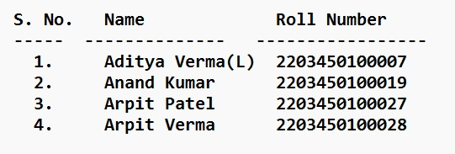
SYNOPSIS PRESENTATION
ElectroMart: A Full-Stack Electronic Commerce Web Application
MongoDB
Express.js
React.js
Node.js
SUBMITTED BY
PROJECT GUIDE
[Guide Name]
[Designation]
Dept. of CSE, SVNIET
Academic Year: 2022–2026
Seth Vishambhar Nath Institute of Engineering and Technology, Barabanki
Safedabad, Lucknow-Barabanki Highway, Barabanki – 225003, Uttar Pradesh
ElectroMart: A Full-Stack Electronic Commerce Web Application | SVNIET, Barabanki | AKTU, Lucknow
2

Slide 3
CONTENTS
01
06
Introduction
Objective
02
07
Motivation
Data Flow Diagram
03
08
Literature Review
Proposed Methodology
04
09
Research Gap
Timeline
05
10
Problem Statement
References
ElectroMart: A Full-Stack Electronic Commerce Web Application | SVNIET, Barabanki | AKTU, Lucknow
3

Slide 4
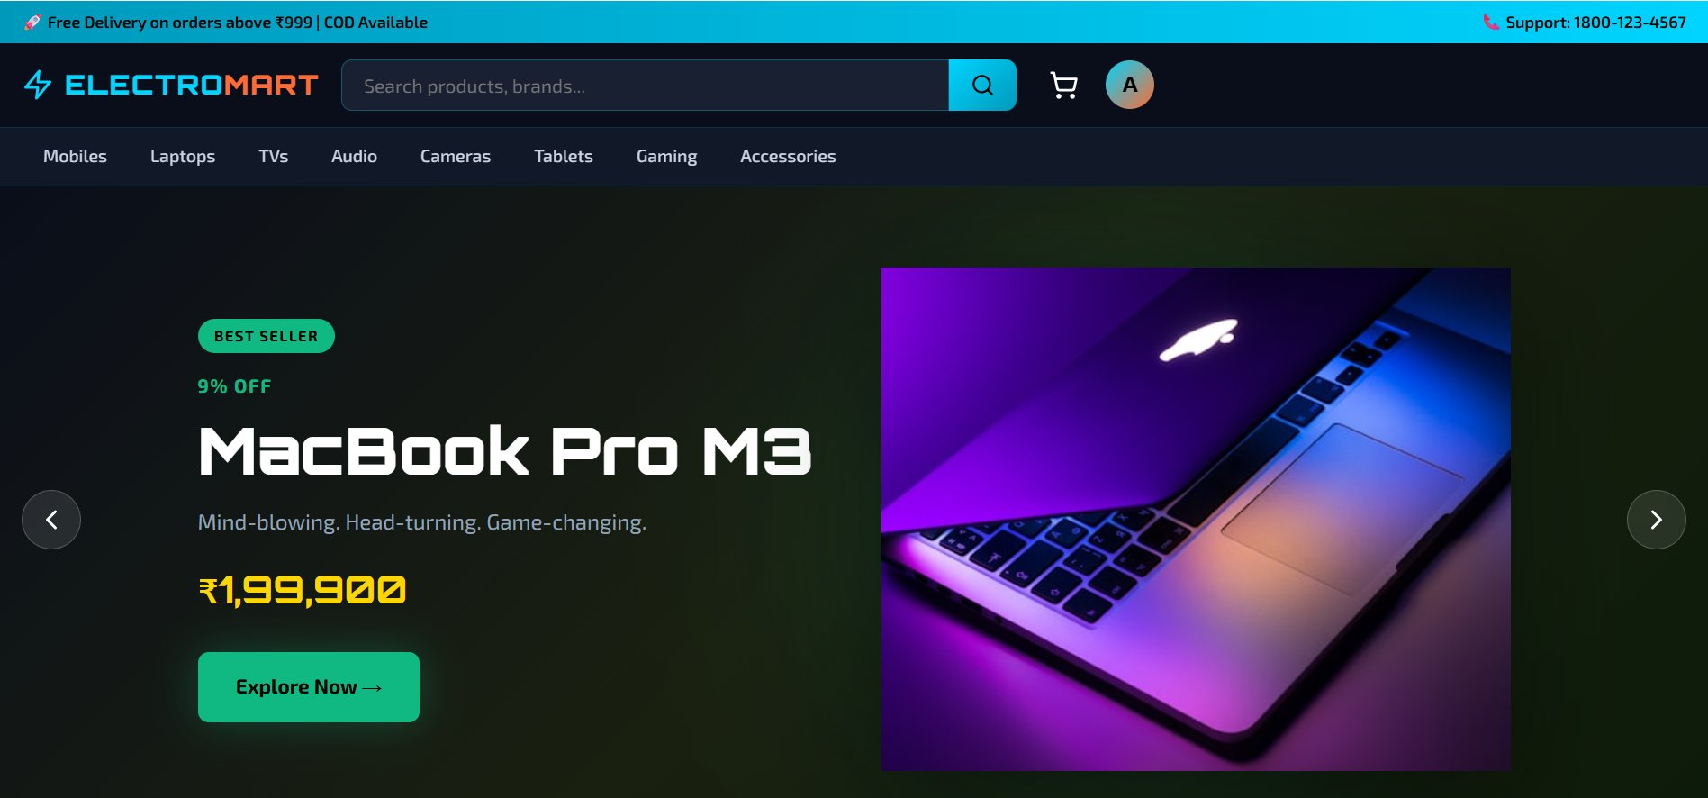
01 | Introduction
What is ElectroMart?
ElectroMart is a production-grade full-stack electronics e-commerce platform built using the MERN Stack — MongoDB, Express.js, React.js, and Node.js.
India's e-commerce market is projected to reach USD 350 billion by 2030, with electronics being the fastest-growing online category.
Small retailers face challenges: limited reach, manual operations, no 24/7 availability, and high commission fees of 8–15% on existing platforms.
₹350B
8
25+
100%
ElectroMart provides a complete open-source solution with zero commission fees, full code ownership, and free-tier cloud deployment.
Market
by 2030
Product
Categories
API
Endpoints
Test
Pass Rate
Two actors — Customers (browse, buy, review, track orders) and Administrators (manage products, orders, users, and analytics).
ElectroMart: A Full-Stack Electronic Commerce Web Application | SVNIET, Barabanki | AKTU, Lucknow
4

Slide 5



02 | Motivation
Market Opportunity
Technical Gap
Academic Value
₹350 Billion Indian e-commerce market projected by 2030
No affordable open-source MERN e-commerce platform exists
Demonstrates complete MERN Stack development competence
Electronics is fastest growing online shopping segment
Platforms charge 8–15% commission — too costly for SMEs
Applies software engineering: MVC, REST API, JWT, responsive design
Growing smartphone & internet use in tier-2/tier-3 cities
Small retailers need customizable solutions with code ownership
Real-world cloud integration: Cloudinary + MongoDB Atlas + Render
ElectroMart: A Full-Stack Electronic Commerce Web Application | SVNIET, Barabanki | AKTU, Lucknow
5

Slide 6
03 | Literature Review
[1]
Laudon & Traver (2021) — E-Commerce: Business, Technology, Society. Pearson.
Finding: Established framework for modern e-commerce architecture. REST APIs and JSON formats are standard for e-commerce backends.
[2]
Kumar & Verma (2023) — Performance Analysis of MERN Stack Web Applications. IJCSE.
Finding: Node.js handles 10,000+ concurrent connections with lower latency vs PHP/MySQL. React virtual DOM reduces rendering by 70%.
[3]
Patel et al. (2022) — Security Analysis of JWT Authentication in RESTful APIs. JWE.
Finding: JWT with bcrypt (salt rounds ≥10) provides adequate security. Stateless auth eliminates server sessions, improving scalability.
[4]
Turban et al. (2020) — Electronic Commerce: Managerial and Social Networks Perspective. Springer.
Finding: Cloud CDN reduces page load time by 40%. Responsive design is critical — 60%+ of Indian users access e-commerce via mobile.
ElectroMart: A Full-Stack Electronic Commerce Web Application | SVNIET, Barabanki | AKTU, Lucknow
6

Slide 7




04 | Research Gap
What Existing Systems Miss:
Gap 1:
No open-source MERN e-commerce platform exists that can be deployed at zero cost with full customization and code ownership.
Gap 2:
Existing platforms (Amazon, Flipkart) do not allow small retailers to run their own branded storefront without paying 8–15% commissions.
Gap 3:
No unified study integrates Cloudinary CDN + JWT auth + MongoDB + React.js in a complete, deployable electronics retail solution.
Gap 4:
Current academic projects lack verified-purchase reviews, admin analytics dashboards, and fully responsive mobile-first design.
ElectroMart: A Full-Stack Electronic Commerce Web Application | SVNIET, Barabanki | AKTU, Lucknow
7

Slide 8
05 | Problem Statement
Small and medium-scale electronics retailers in India lack an affordable, feature-rich, open-source e-commerce platform that provides 24/7 online presence, automated order management, real-time inventory tracking, and business analytics — without paying high commissions to third-party marketplaces.
✕ Limited Reach
✕ Manual Operations
✕ No 24/7 Presence
Physical stores serve only local area; unable to reach online customer base
Order tracking and inventory done manually, causing costly errors and delays
Fixed store hours mean missed sales opportunities after business hours
✕ High Commissions
✕ No Analytics
✕ Poor Customer Trust
Platforms like Amazon/Flipkart charge 8–15% commission per transaction
No data on sales trends, customer behavior, or popular products available
No professional online storefront reduces credibility with digital shoppers
ElectroMart: A Full-Stack Electronic Commerce Web Application | SVNIET, Barabanki | AKTU, Lucknow
8

Slide 9





06 | Objective
O1 — Full-Stack MERN Platform
O2 — Secure Authentication
Complete e-commerce using MongoDB, Express.js, React.js 18, and Node.js.
JWT + bcryptjs (salt:10) with role-based access control (user/admin).
O3 — RESTful API Design
O4 — Responsive UI
25+ REST endpoints for products, orders, users, reviews, and admin ops.
React.js frontend for Desktop (1024px+), Tablet (768px), Mobile (480px).
O5 — Payment Module
O6 — Admin Dashboard
COD + Mock Card payment with 2-step checkout: address → payment.
KPI analytics, product CRUD with Cloudinary upload, order pipeline.
O7 — Cloud Image Management
O8 — Review & Rating System
Cloudinary: auto-resize to 800×800px, up to 5 images per product.
Star ratings + text reviews with verified-purchase badge for buyers.
ElectroMart: A Full-Stack Electronic Commerce Web Application | SVNIET, Barabanki | AKTU, Lucknow
9

Slide 10
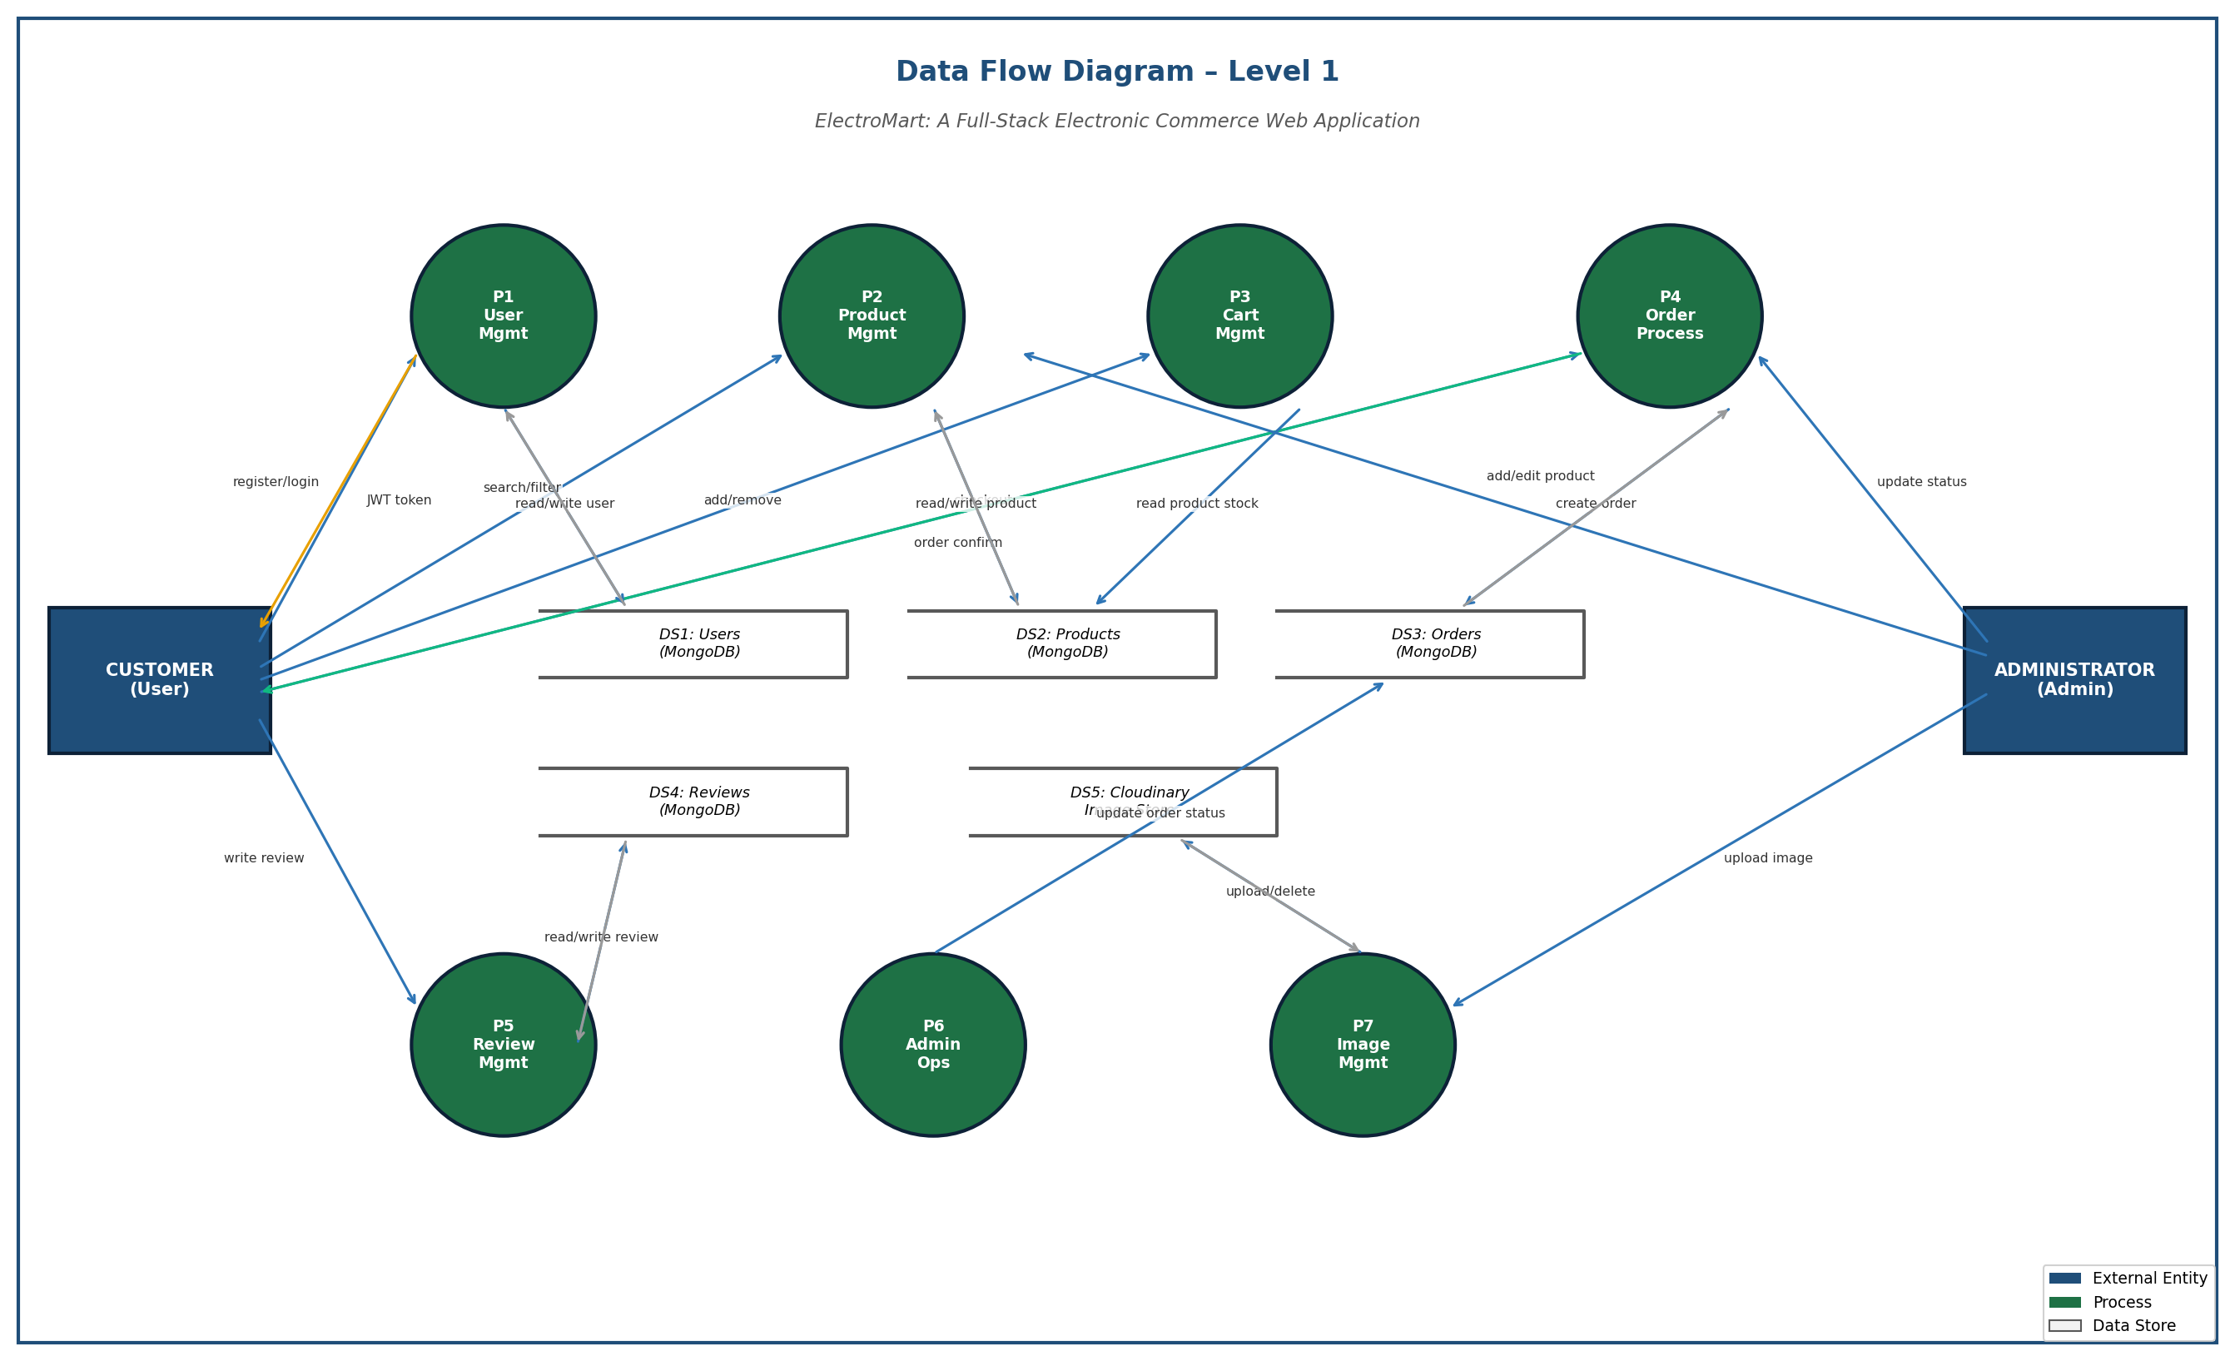
07 | Data Flow Diagram
ElectroMart: A Full-Stack Electronic Commerce Web Application | SVNIET, Barabanki | AKTU, Lucknow
10

Slide 11
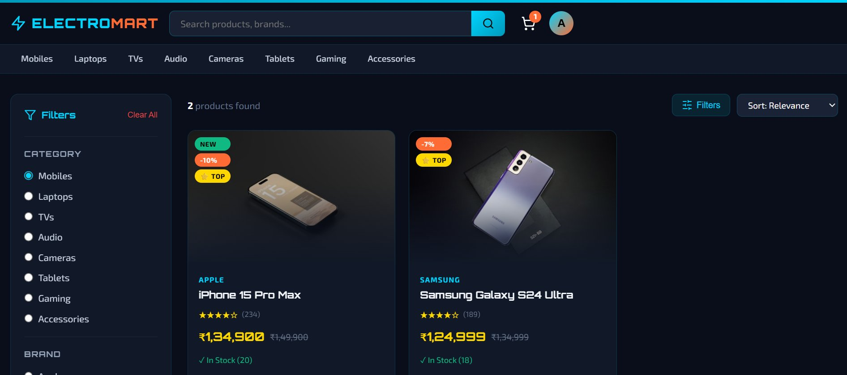
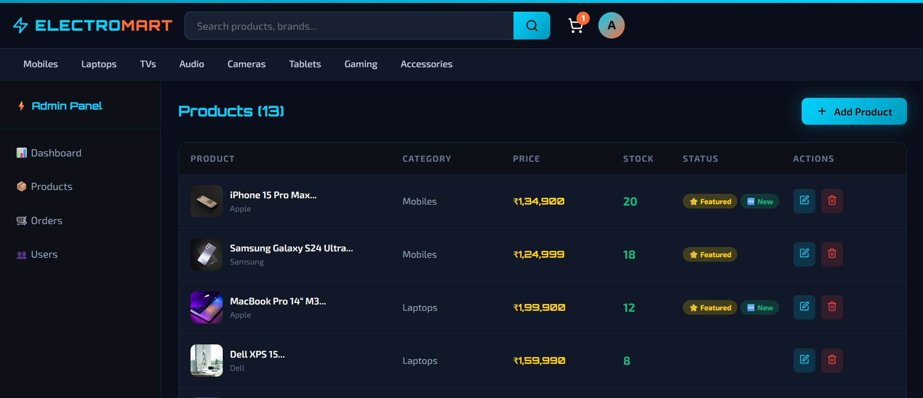
08 | Proposed Methodology
System developed using MERN Stack with Cloudinary, JWT Authentication, and RESTful API design principles.
1
Requirement Analysis
Functional requirements, use cases, actors definition, scope & feasibility
2
System Design
Three-tier architecture, ER diagram, API endpoint design, MongoDB schema, wireframes
3
Database Creation
MongoDB collections: Users, Products, Orders, Reviews with Mongoose ODM validation
4
Product Listing Page
Coding & Integration
Express.js REST API + React.js frontend + JWT auth + Cloudinary image upload pipeline
5
Testing & Validation
30 black-box test cases across User & Admin modules — achieved 100% pass rate
6
Deployment
Render.com (backend) + Vercel (frontend) + MongoDB Atlas (database) — all free tier
Admin Products Panel
ElectroMart: A Full-Stack Electronic Commerce Web Application | SVNIET, Barabanki | AKTU, Lucknow
11

Slide 12
09 | Timeline
Month 1
Month 3
Month 5
Requirement
Analysis
Backend
Development
Integration
& Testing
Feasibility study,
scope, wireframes
Node.js, JWT auth,
MongoDB integration
30 test cases,
bug fixes, validation
Month 2
Month 4
Month 6
System Design
& DB
Frontend
Development
Deployment
& Docs
ER diagram, API,
MongoDB schema
React.js, Context API,
Axios, responsive CSS
Render + Vercel +
Atlas, report, PPT
ElectroMart: A Full-Stack Electronic Commerce Web Application | SVNIET, Barabanki | AKTU, Lucknow
12

Slide 13
10 | References
[1] Laudon, K. C., & Traver, C. G. (2021). E-Commerce: Business, Technology, Society (17th ed.). Pearson Education.
[2] Turban, E., et al. (2020). Electronic Commerce: A Managerial and Social Networks Perspective (9th ed.). Springer.
[3] Kumar, R., & Verma, S. (2023). Performance Analysis of MERN Stack Web Applications. IJCSE, Vol. 12(3), pp. 145–158.
[4] Patel, A., et al. (2022). Security Analysis of JWT Authentication in RESTful APIs. JWE, Vol. 8(2), pp. 89–102.
[5] React.js Official Documentation (2024). Components, Hooks, and Context API. Meta Open Source. https://react.dev/
[6] MongoDB, Inc. (2024). MongoDB Manual — CRUD Operations, Aggregation Pipeline. https://www.mongodb.com/docs/
[7] Cloudinary Ltd. (2024). Cloudinary Developer Documentation — Upload API. https://cloudinary.com/documentation/
[8] Jones, M., et al. (2015). JSON Web Token (JWT) — RFC 7519. IETF. https://jwt.io/introduction/
[9] Brown, E. (2019). Web Development with Node and Express (2nd ed.). O'Reilly Media.
[10] Pressman, R. S. (2015). Software Engineering: A Practitioner's Approach (8th ed.). McGraw-Hill Education.
ElectroMart: A Full-Stack Electronic Commerce Web Application | SVNIET, Barabanki | AKTU, Lucknow
13

Slide 14
Thank You!
ElectroMart: A Full-Stack Electronic Commerce Web Application
Questions & Answers Welcome
Guide: [Guide Name] | Dept. of CSE, SVNIET, Barabanki
AKTU, Lucknow | B.Tech CSE | Academic Year: 2024–2025
Aditya Verma | Anand Kumar | Arpit Patel | Arpit Verma
MongoDB
Express.js
React.js
Node.js
Cloudinary
JWT Auth
Seth Vishambhar Nath Institute of Engineering and Technology, Barabanki | AKTU, Lucknow

